Slide 1
Open CV
(open source computer library)

Slide 2
Computer Vision
(open source computer library)
Computer vision is the field of computer science that focuses on enabling computers to identify and process objects in images and videos in the same way that humans do. one way to train a computer how to understand visual data is to feed it images, lots of images thousands, millions if possible that have been labeled, and then subject those to various software techniques, or algorithms, that allow the computer to hunt down patterns in all the elements that relate to those labels.

Slide 3
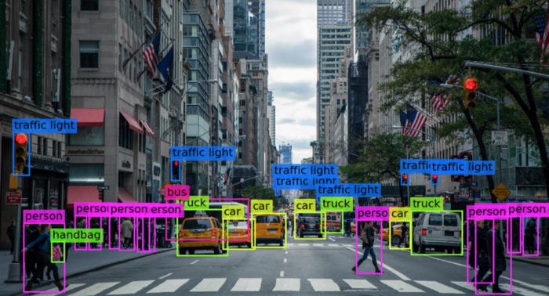

Slide 4
So, for example, if you feed a computer a million images of cats (we all love them it will subject them all to algorithms that let them analyze the colors in the photo, the shapes, the distances between the shapes, where objects border each other, and so on, so that it identifies a profile of what “cat” means. When it’s finished, the computer will (in theory) be able to use its experience if fed other unlabeled images to find the ones that are of cat.

Slide 5
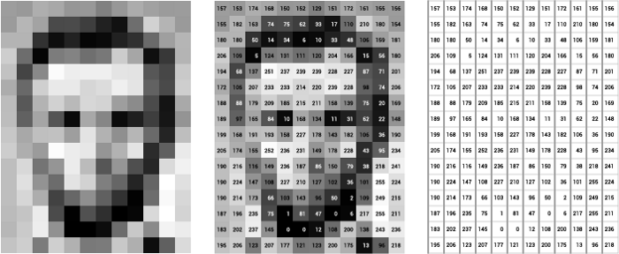
Let’s leave our fluffy cat friends for a moment on the side and let’s get more technical🤔😹. Illustration of the grayscale image buffer which stores our image of Abraham Lincoln. Each pixel’s brightness is represented by a single 8-bit number, whose range is from 0 (black) to 255 (white):

Slide 6
In point of fact, pixel values are almost universally stored, at the hardware level, in a one-dimensional array. For example, the data from the image above is stored in a manner similar to this long list of unsigned chars:
{157, 153, 174, 168, 150, 152, 129, 151, 172, 161, 155, 156, 155, 182, 163, 74, 75, 62, 33, 17, 110, 210, 180, 154, 180, 180, 50, 14, 34, 6, 10, 33, 48, 106, 159, 181, 206, 109, 5, 124, 131, 111, 120, 204, 166, 15, 56, 180, 194, 68, 137, 251, 237, 239, 239, 228, 227, 87, 71, 201, 172, 105, 207, 233, 233, 214, 220, 239, 228, 98, 74, 206, 188, 88, 179, 209, 185, 215, 211, 158, 139, 75, 20, 169, 189, 97, 165, 84, 10, 168, 134, 11, 31, 62, 22, 148, 199, 168, 191, 193, 158, 227, 178, 143, 182, 106, 36, 190, 205, 174, 155, 252, 236, 231, 149, 178, 228, 43, 95, 234, 190, 216, 116, 149, 236, 187, 86, 150, 79, 38, 218, 241, 190, 224, 147, 108, 227, 210, 127, 102, 36, 101, 255, 224, 190, 214, 173, 66, 103, 143, 96, 50, 2, 109, 249, 215, 187, 196, 235, 75, 1, 81, 47, 0, 6, 217, 255, 211, 183, 202, 237, 145, 0, 0, 12, 108, 200, 138, 243, 236, 195, 206, 123, 207, 177, 121, 123, 200, 175, 13, 96, 218};

Slide 7
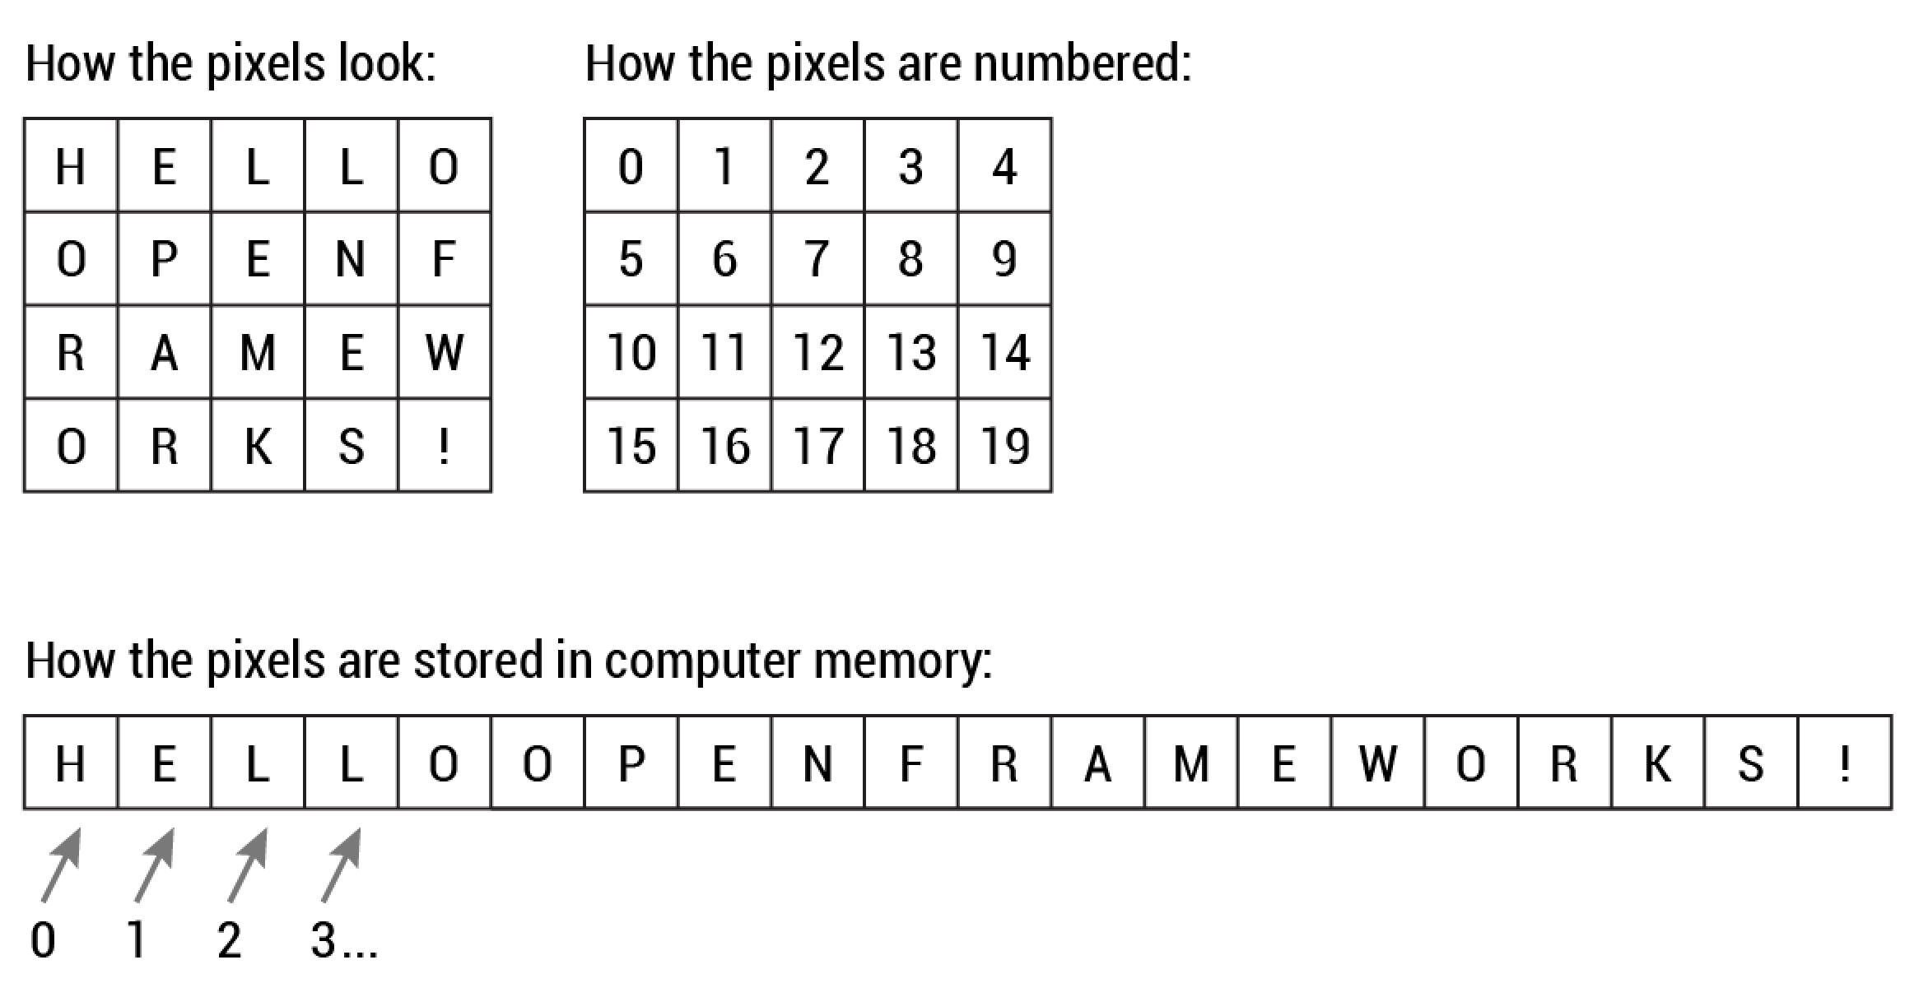
Way of storing images in computer’s memory

Slide 8
Way of storing images in computer’s memory
OpenCV is the huge open-source library for the computer vision, machine learning, and image processing and now it plays a major role in real-time operation which is very important in today’s systems. By using it, one can process images and videos to identify objects, faces, or even handwriting of a human. When it integrated with various libraries, such as Numpy, python is capable of processing the OpenCV array structure for analysis. To Identify image pattern and its various features we use vector space and perform mathematical operations on these features.

Slide 9

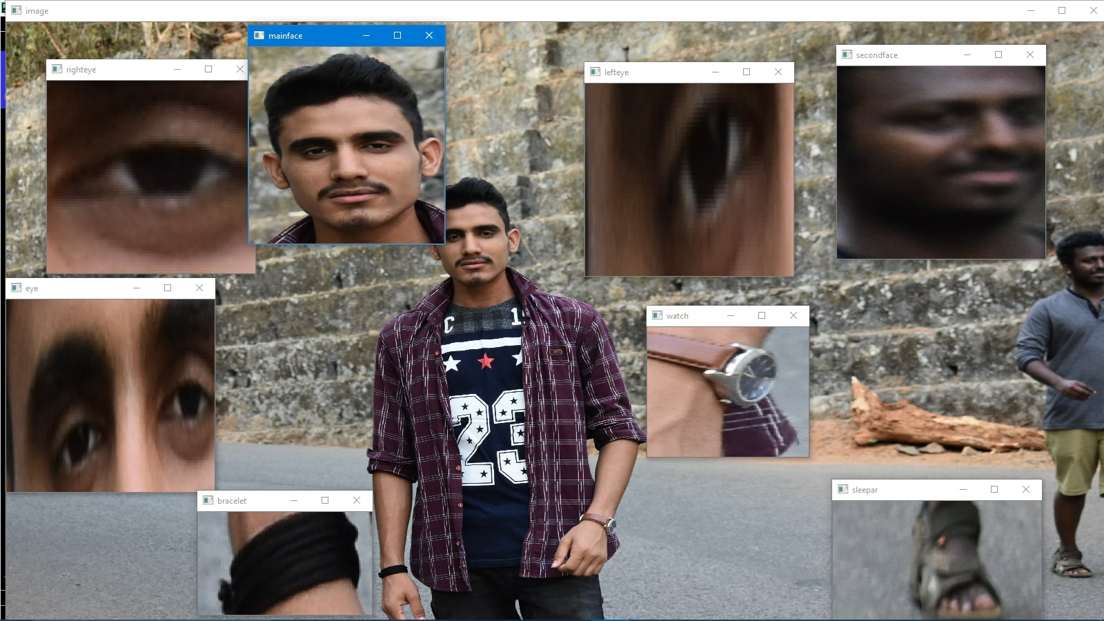
For instance

Slide 10
For instance
Like in the above image there are two faces available and the person(I) in the images wearing a bracelet, watch, etc. so by the help of OpenCV we can get all these types of information from the original image.

